Slide 1
Security in Microsoft Azure
Davide Spano

Slide 2
The Author and Speaker
Davide Spano
(davide.spano@wuerth-phoenix.com)
2007 - MSc in Mechanical Engineering Robotics and Automatics, University of Brescia, Faculty of Engineering
2007 – 2018 Worked in the UK as Software Engineer in several technical and non technical fields such as mechatronics, instrumentation, finance, insurance and pension sectors
2018, October – joined Würth-Phoenix in the SpeedyTouch team where I help with the development of the new product SpeedyLead

Slide 3
Introduction
The business case for security
Businesses need to manage a variety of (sensitive) information
Firms are required to handle security concern adequately to stay in business
Handling of the information may be regulated by policies and law
Firms are opened to security threats due to the valuable information they hold
Responsibility for the handling of the info might be delegated to the business
Information might or might not be direct property of the business
Information can be heterogeneous
Some info is operational and is used as key to access larger repositories of data
Some information may be classified as secret and should be handled accordingly
Misuse or mishandling of information can lead to loss
Intrusion in secure area of the business or exploitation of data can lead to loss

Slide 4
Overview
Open Web Application Security Project (OWASP)
Secure Secrets
Encryption
Authorization
Working at Würth-Phoenix

Slide 5
OWASP
Open Web Application Security Project

Slide 6
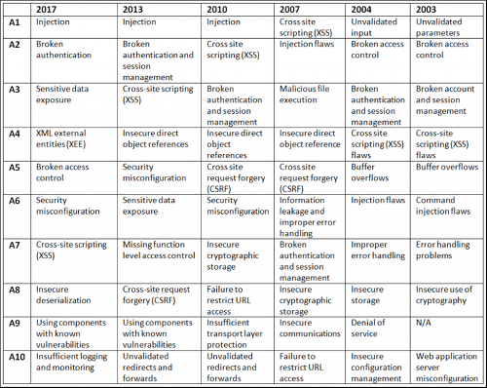
Threats

Slide 7
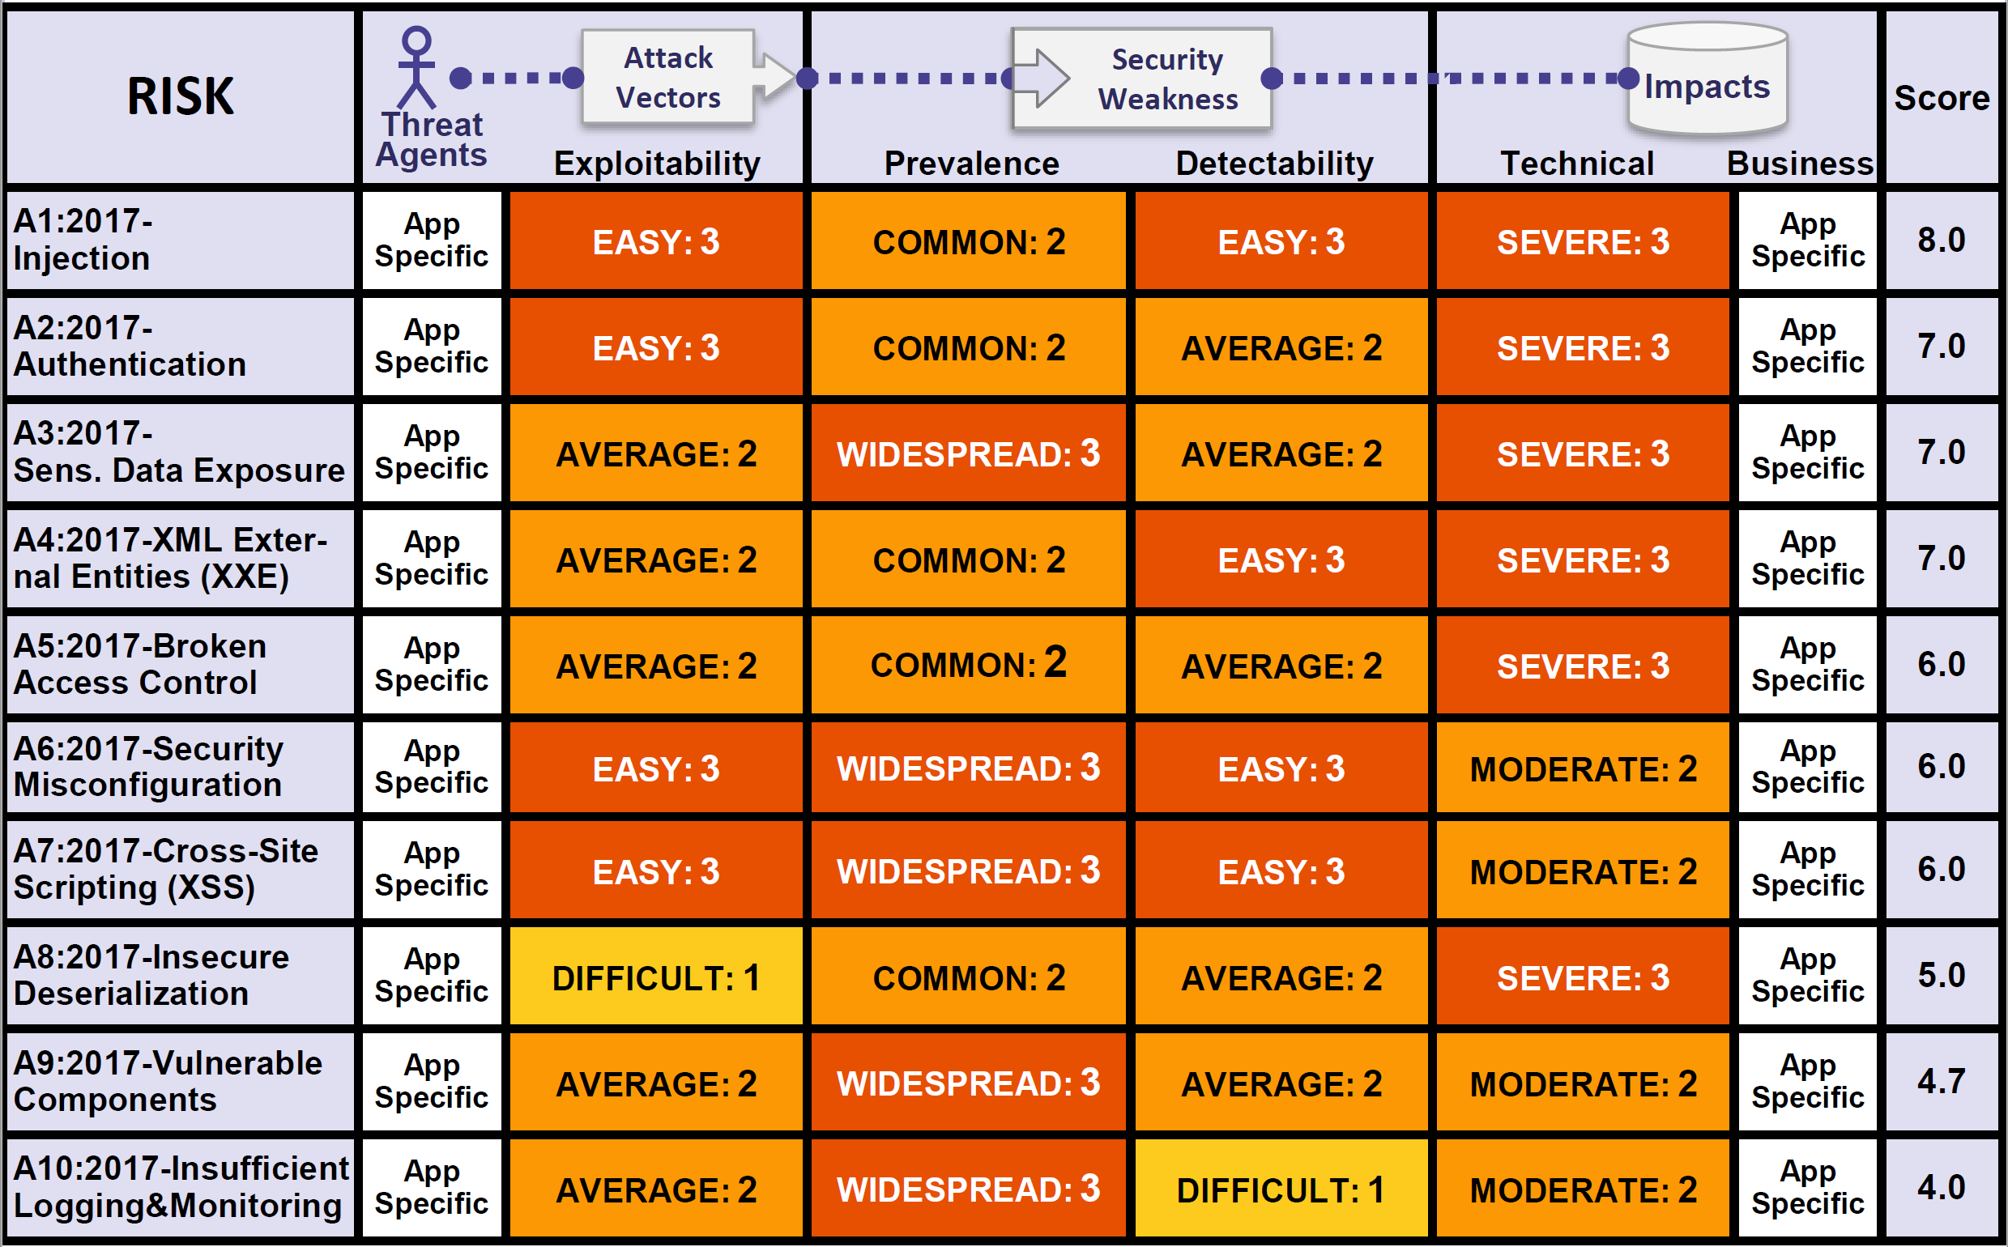
OWASP Table

Slide 8
Summary on OWASP
Open Web Application Security Project
An online community that produces freely-available articles, methodologies, documentation, tools, and technologies in the field of web application security
A frame of reference to keep up-to-date with security threats

Slide 9
Any Questions?

Slide 10
Secrets

Slide 11
Secrets
It must be kept safe somewhere
It cannot (even accidentally) be shared with anyone who should not know
It can be forgotten, lost, stolen or corrupted in which case becomes worthless and/or can cause loss of assets
Just the suspicion of loss or of accidental leak makes it worthless and a liability
More than one secret and life gets very complicated!

Slide 12
Demo
A Very Bad App!

Slide 13
Where to store a secret?
Where to store a server side encryption key?
This is a good question posed on Stack Exchange Information Security.
Use an external Hardware Security Module
Tie the encryption key to your hardware i.e. TPM chips
Tie the encryption key to your admin login
Type in the encryption key when you start up, store it in memory
Store the key on a different server

Slide 14
The Problems with Secrets
It must be kept safe somewhere
It cannot be shared with anyone who should not know
It can be forgotten or lost
If stolen it becomes worthless
Just the suspicion of loss or of a leak makes it worthless
More than one secret and life gets very complicated!

Slide 15
What is Azure Key Vault
A storage service used to store cryptographic keys and secrets and keep this information secure. The service offers a software abstraction to solve the following problems.
Secret and Keys management such as access control.
Certificate management including provision and deployment i.e. (SSL/TLS) certificates used within Azure internally connected artifacts.
Store secrets and Keys on HSMs

Slide 16
Resource Types in Azure Key Vault
Secrets
Keys
Certificates
Secrets
Binary sequences with no semantic i.e. passwords, connection strings, bank details, thumbprints, hashes, etc. Any sensitive information that must be protected and access controlled. Any piece of information that may be versioned and needs to be centrally managed.

Slide 17
Resource Types in Azure Key Vault
Secrets
Keys
Certificates
Cryptographic Keys
Existing RSA (Rivest–Shamir–Adleman) or EC (Elliptic Curve) Keys. These can either be imported into Azure Key Vault or be directly generated and stored by it. A cryptographic key is a string of bits used by a cryptographic algorithm to transform plain text into ciphertex or vice versa. Their format is an agreed industry standard.

Slide 18
Resource Types in Azure Key Vault
Secrets
Keys
Certificates
Certificates
Data files which that digitally bind a cryptographic key(s) to an organization and prove ownership. The majority of certificates are Public Key Certificates (PKC) which holds information about the key(s) and their owner(s). The PKC is digitally signed by the Authority that has verified the certificate’s content. The most common format for PKC is X.509.

Slide 19
What is Certificate
A certificate contains a public key and additional information such as issuer, what the certificate is supposed to be used for, and other types of metadata. It is signed by a certificate authority (CA) using CA's private key. This allows the recipient of the certificate to verify the authenticity of the certificate itself.

Slide 20
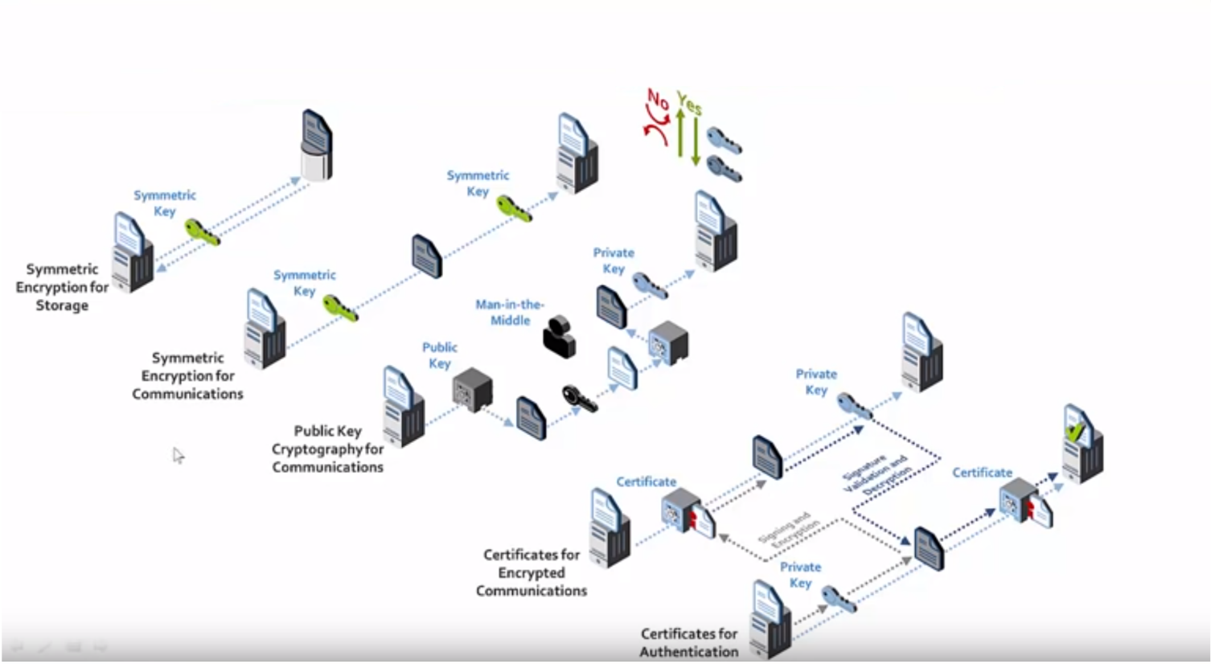
Symmetric and Asymmetric Encryption

Slide 21
Man-in-the-middle attack
Alice wishes to communicate with Bob. Mallory intercepts the conversation of the key exchange and obtains Bob’s PK and send Alice its PK instead now Mallory can send false messages to Bob and read Alice’s.
Alice, believing this public key to be Bob's, encrypts her message with Mallory's key and sends the enciphered message back to Bob. Mallory again intercepts, deciphers the message using her private key, possibly alters it if she wants, and re-enciphers it using the public key she intercepted from Bob when he originally tried to send it to Alice. When Bob receives the newly enciphered message, he believes it came from Alice.

Slide 22
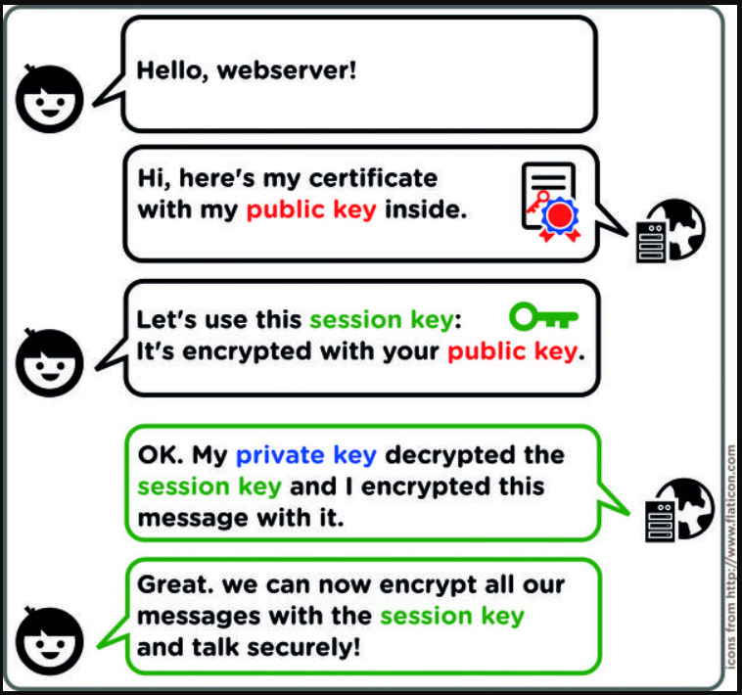
How a Certificate is Used

Slide 23
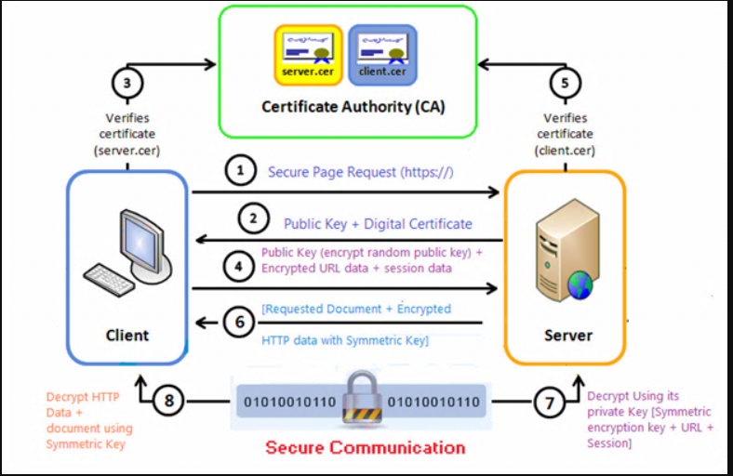
How a Certificate is Used

Slide 24
Demo
The Very Bad App gets a bit better thanks to Azure Key Vault

Slide 25
The Azure Key Vault Approach
Based on registering apps with Azure AD
Exchange of client ID and shared secret or certificate based
The secrets still fly over the public/private infrastructure and might need TSL if it is not private only and secure connection.
It is useful for scenarios of interconnected systems on private networks which may be not all part of Azure infrastructure (hybrid)
It is necessary in all cases in which a secret is required to connect two pieces of software but any of the two cannot use Azure AD as authentication service i.e. Azure Cache for Redis

Slide 26
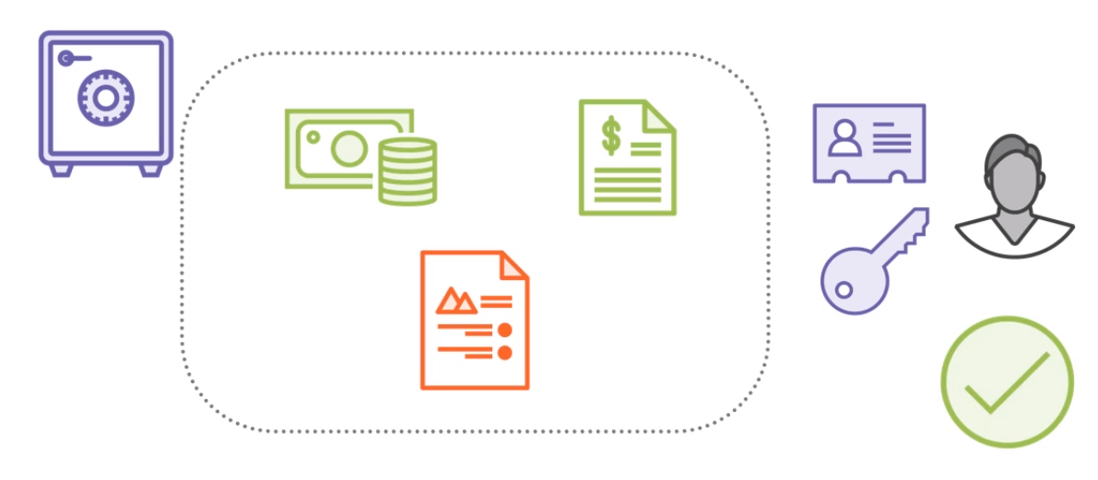
The Bank Vault Analogy

Slide 27
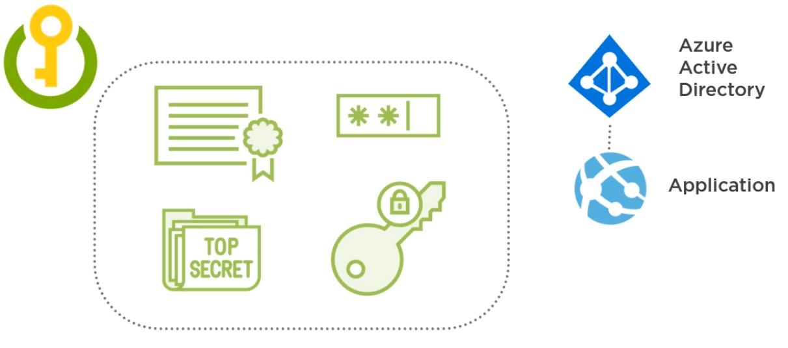
The Key Vault Approach

Slide 28
Demo
The Very Bad App gets much better with Azure Key Vault and Certificate

Slide 29
The Managed Service Identity Approach
Based on registering apps and Services with Azure AD
No need for client ID, shared secret, certificates or configuration files
Authentication and Authorization happen within Azure infrastructure
Lower complexity compared with the Azure Key Vault approach
Ever expanding number of Azure services support this model
Fined grained control over authorization via role-based access control (RBAC)

Slide 30
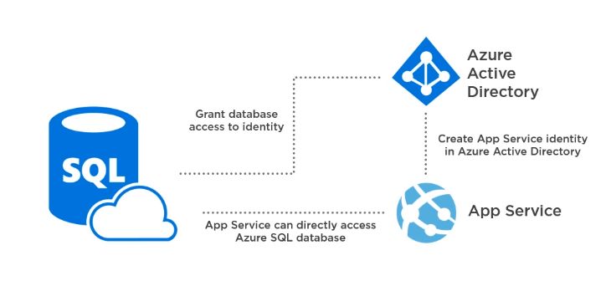
The Managed Service Identity Approach

Slide 31
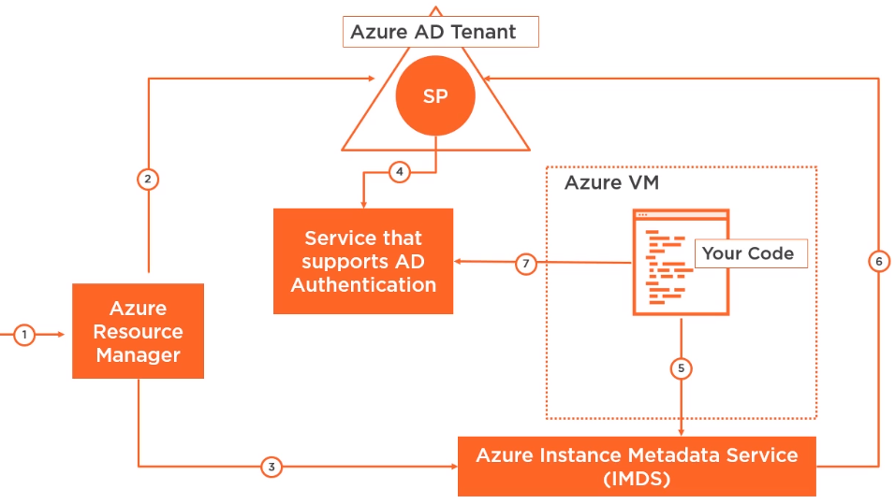
The Managed Service Identity Flow

Slide 32
Demo
A very secure app with MSI

Slide 33
Summary on Secrets
Some business information can be qualified as Secrets
Secrets are generally some form of cryptographic key
Secrets must be stored and accessed securely
Secrets must not be accidentally or intentionally leaked
Secrets should be versioned and rotated
Secrets should not be accidentally lost or deleted
Secrets must be exchanged securely
Azure Key Vault provides a solution to all these requirements
Managed Service Identity (MSI) is a better solution when applicable

Slide 34
Any Questions?

Slide 35
Encryption

Slide 36
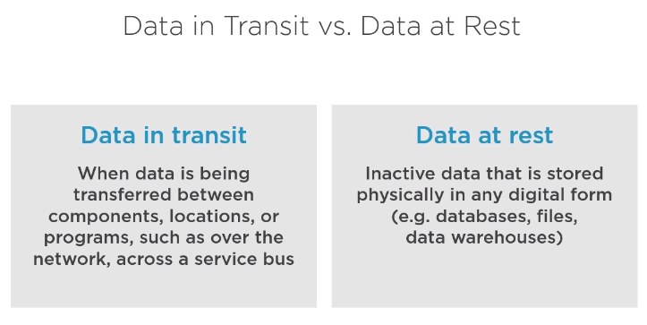

Slide 37
Azure Storage Service Encryption (SSE)
Encryption of data at rest for PaaS
Transparently encrypts your data when persisting it to the cloud.
Helps to meet organizational security and compliance commitments.
Data in Azure Storage is encrypted and decrypted transparently using 256-bit Advanced Encryption Standard (AES)
It is enabled by default and cannot be disabled for any storage account
It encrypts blobs, disks, files, queues, tables and Azure Managed Disks and any metadata pertaining to these artifacts.
It does not cause performance loss and it’s free
Works with Managed and Customer keys thus can be rotated, audited, etc. in which case the customer key is stored in Key Vault and accessed via Managed Service Identity (MSI).
It does not cover SQL Server

Slide 38
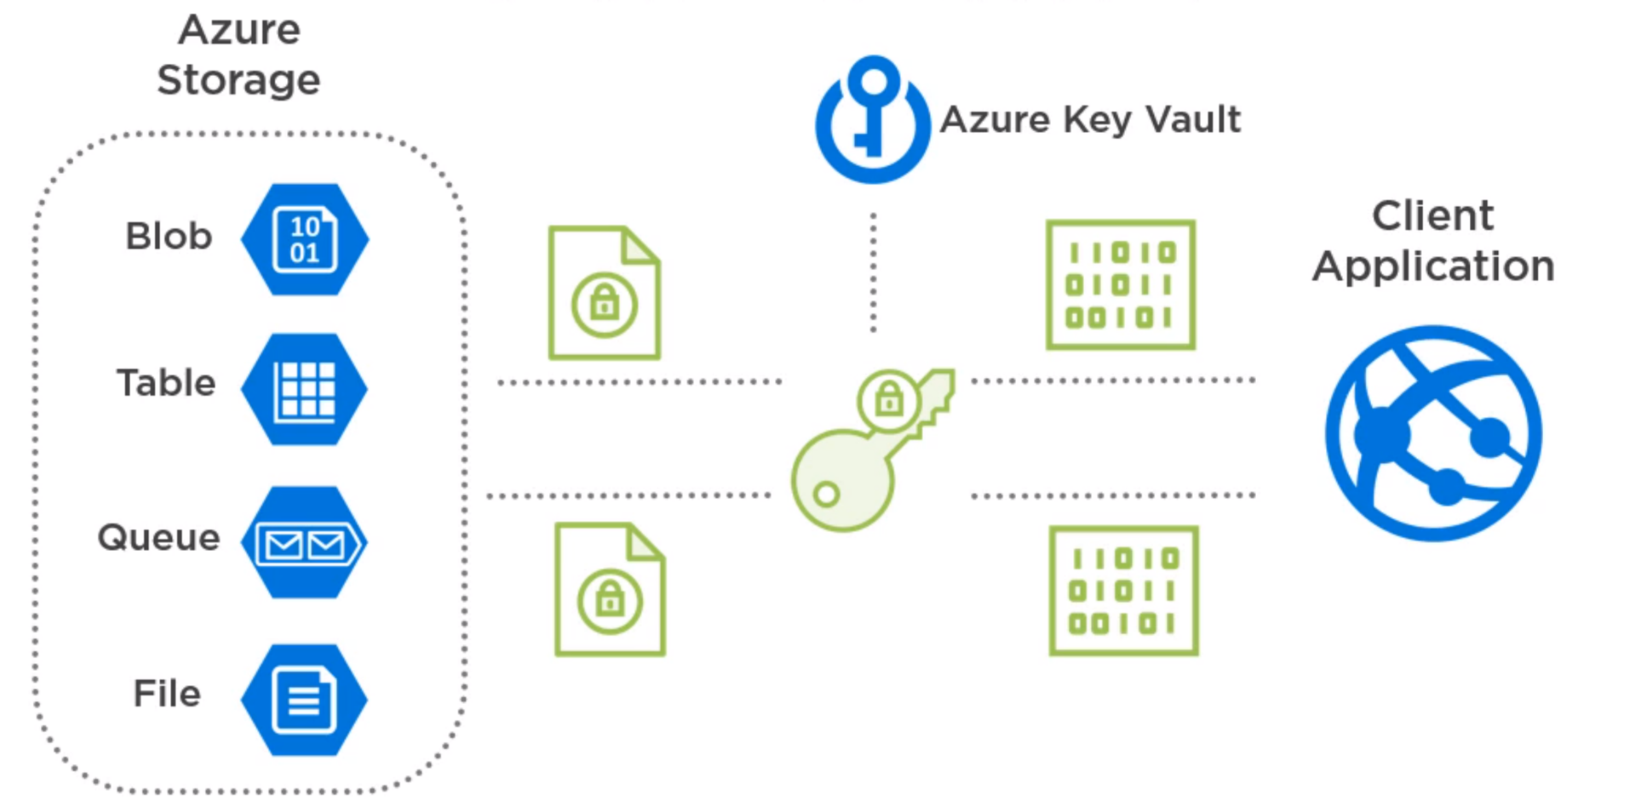
How does SSE work?

Slide 39
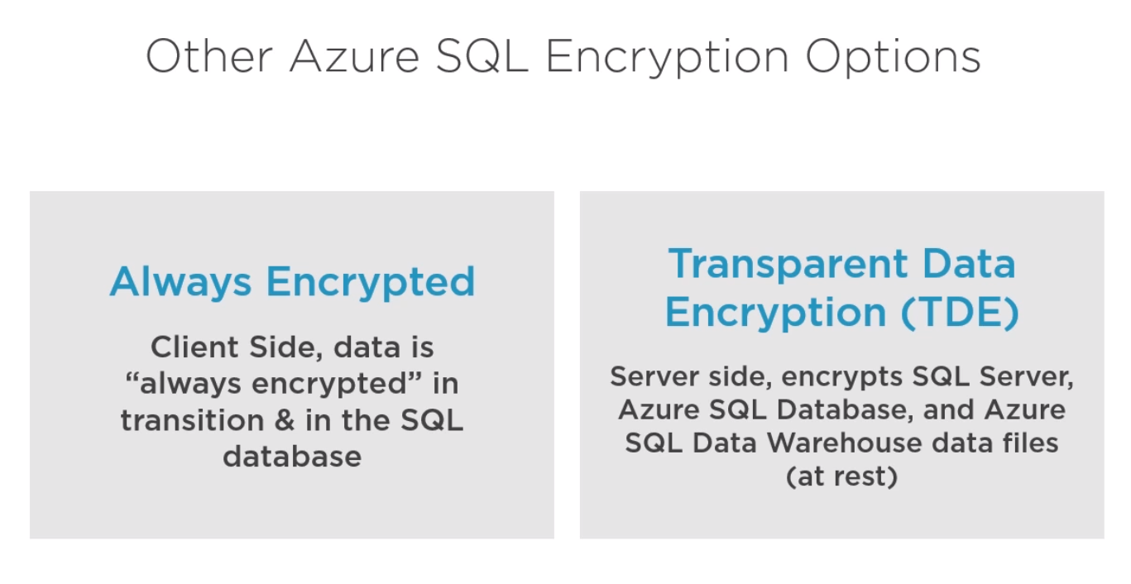

Slide 40
Azure SQL Server Always-Encrypted technology
Encryption technology for Azure SQL Server
Info can be saved in Azure SQL Server Database in plain format
Some information is sensitive and should not be stored in plain format in a database i.e. SSN, financials, personal data, passwords, DOBs, salaries, etc.
Protect the sensitive information i.e. DBAs need not know
Encryption of sensitive columns of a database
It’s a client-side technology that is the data is encrypted in transit and decrypted/encrypted on the client site

Slide 41
How does Always-Encrypted work?
There are two keys involved the CEK and the CMK
These keys can be created using SSMS
The CMK is stored on Azure Key Vault
The CMK is used to encrypt and decrypt the CEK on the client side
The CEK is stored in the database as encrypted key
Clients read data from the database together with the encrypted CEK but need the CMK to decrypt encrypted columns
Any registered Azure AD identity with proper claims to read the CMK is able to decrypt the CEK and decrypt/encrypt data for protected columns

Slide 42
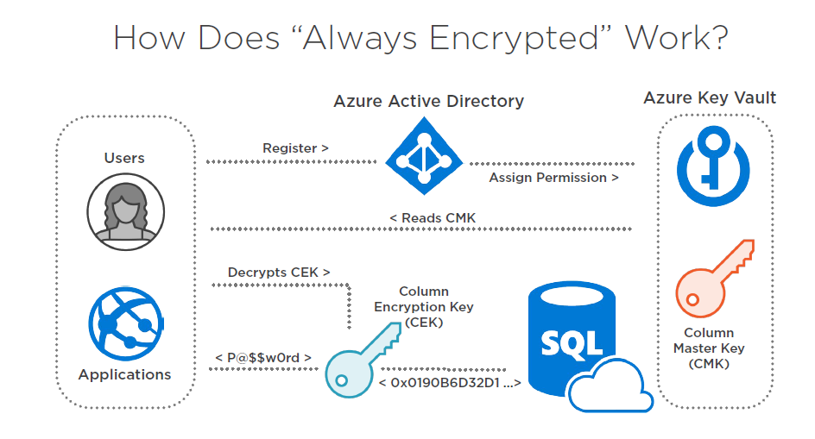

Slide 43
Always-Encrypted bonus
It offers two modes of columns encryption deterministic vs randomized
Randomized offers higher security but it prevents some typical SQL operations such as joins, indexes, etc.
Deterministic is less secure but it makes it possible to employ the usual SQL constructs i.e. joins, indexes, etc.

Slide 45
Azure SQL Server Transparent Data Encryption (TDE)
Encryption technology for Azure SQL Server (at rest)
It encrypts the database files
Azure SQL databases, Azure SQL Data Warehouse and data files
It is on by default on any Azure SQL Server database
It is similar in concept to Storage Service Encryption (SSE) that is the analogous technology available on Azure storage accounts
Can use managed or customer encryption keys as for SSE
Can be enabled at Server or database level

Slide 46
Azure Disk Encryption for IaaS (ADE)
Protection feature against data theft
To encrypt OS and Data disks of Linux & Windows VMs
These disks are hosted on Azure Blob Storage (Page Blobs)
On Windows BitLocker is used while on Linux dm-crypt
Part of the defense in depth strategy to security
Not enabled by default
A custom encryption key is used and can be stored in Key Vault

Slide 47
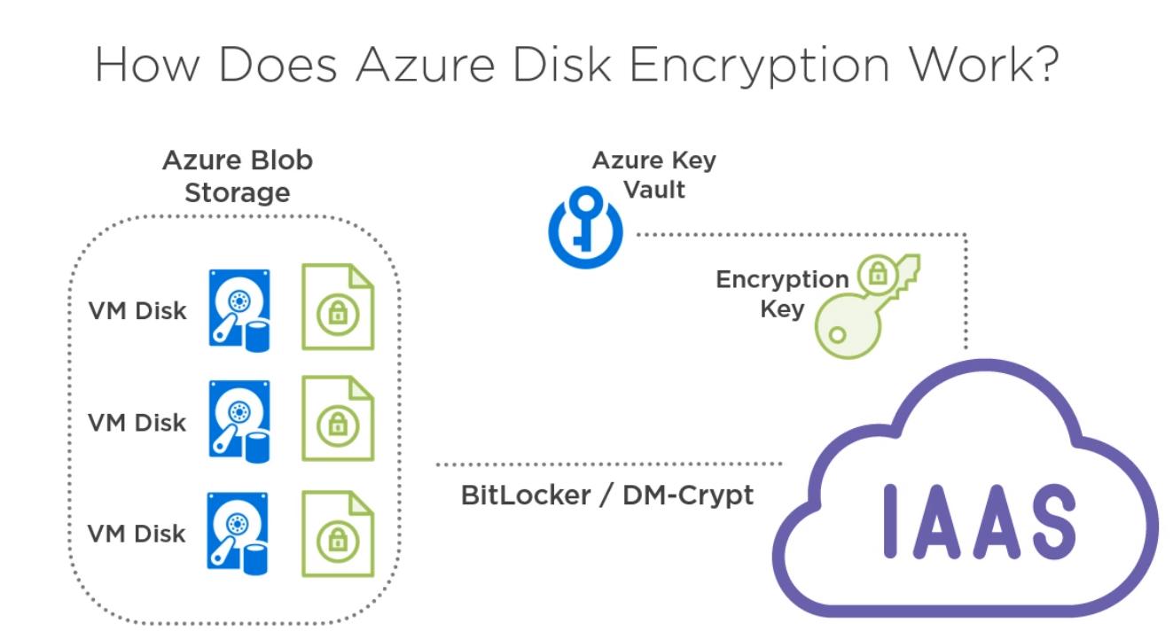

Slide 48
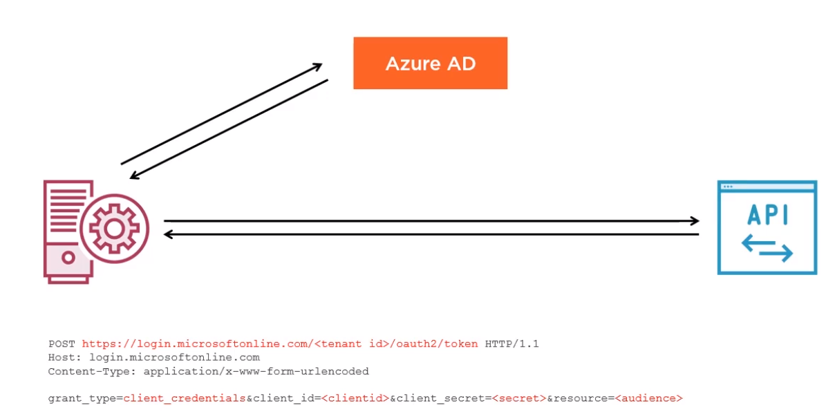
The Client Credential Grant Flow
Machine-To-Machine Communication
No user is involved!

Slide 49
Summary on Encryption
Storage Accounts are transparently encrypted at rest via SSE
For Azure SQL Server Azure Transparent Data Encryption (TDE) as server-side default encryption for data at rest. It encrypts the whole server or the database files with either a custom or managed key.
For Azure SQL Server Always-Encrypted Client Technology based on CMK &CEK

Slide 50
Any Questions?

Slide 51
Authentication and Authorization
OAuth, Flows and Azure AD

Slide 52
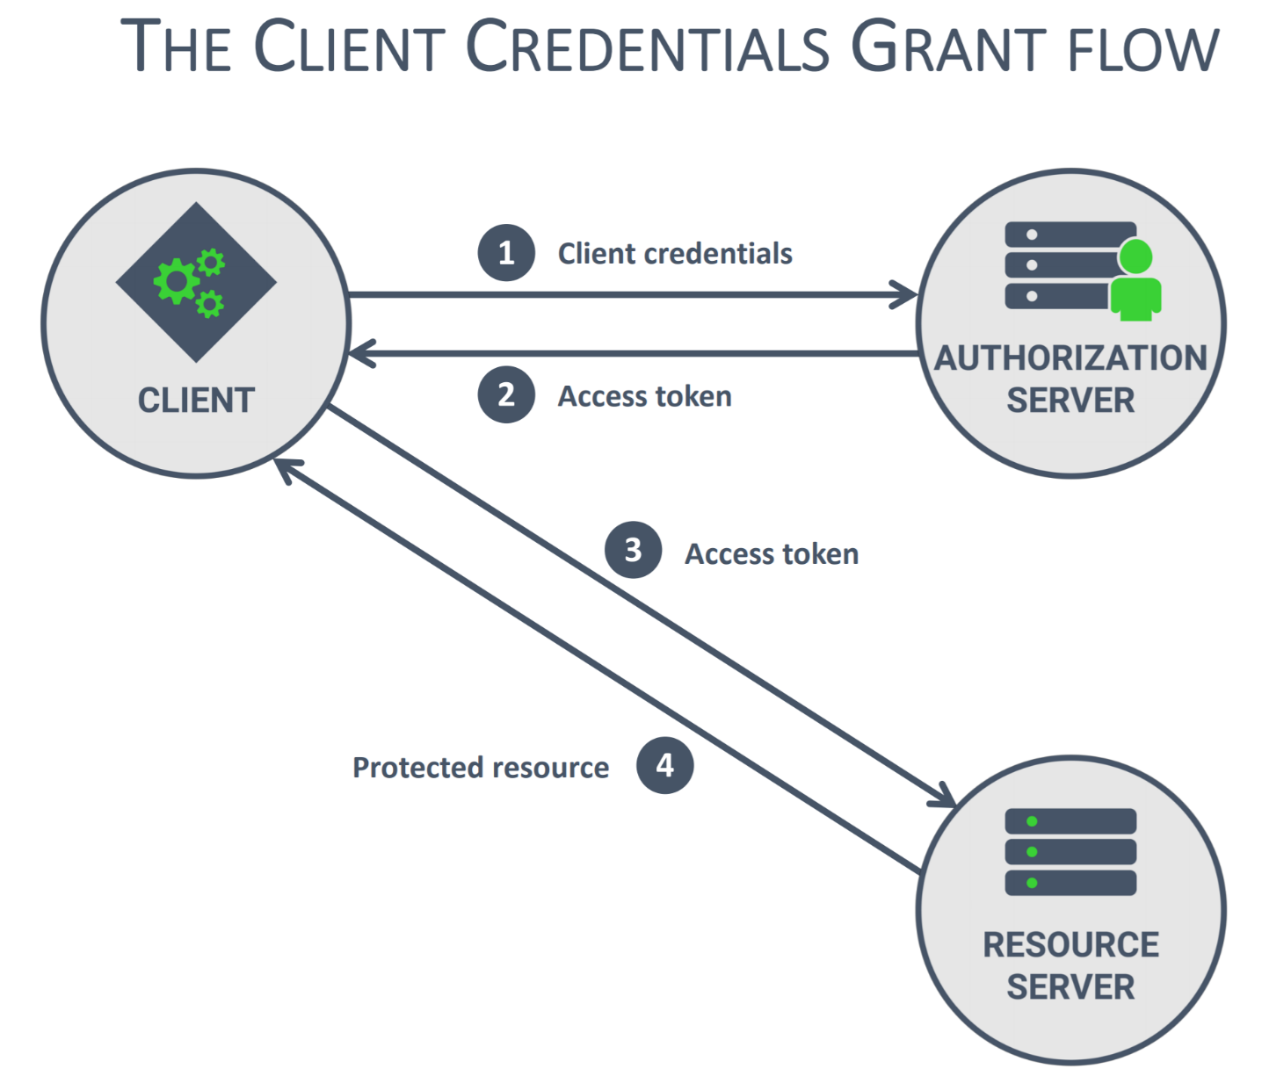

Slide 53
The Client Credential Grant Flow
It is only for direct access by the client application
An Access Token is obtained from the AS presenting client credentials
It is meant for machine-to-machine communication
No user involved
It is the simplest flow possible
It is the less secure flow possible
It employs secrets which are assumed to be stored securely on a backend

Slide 54
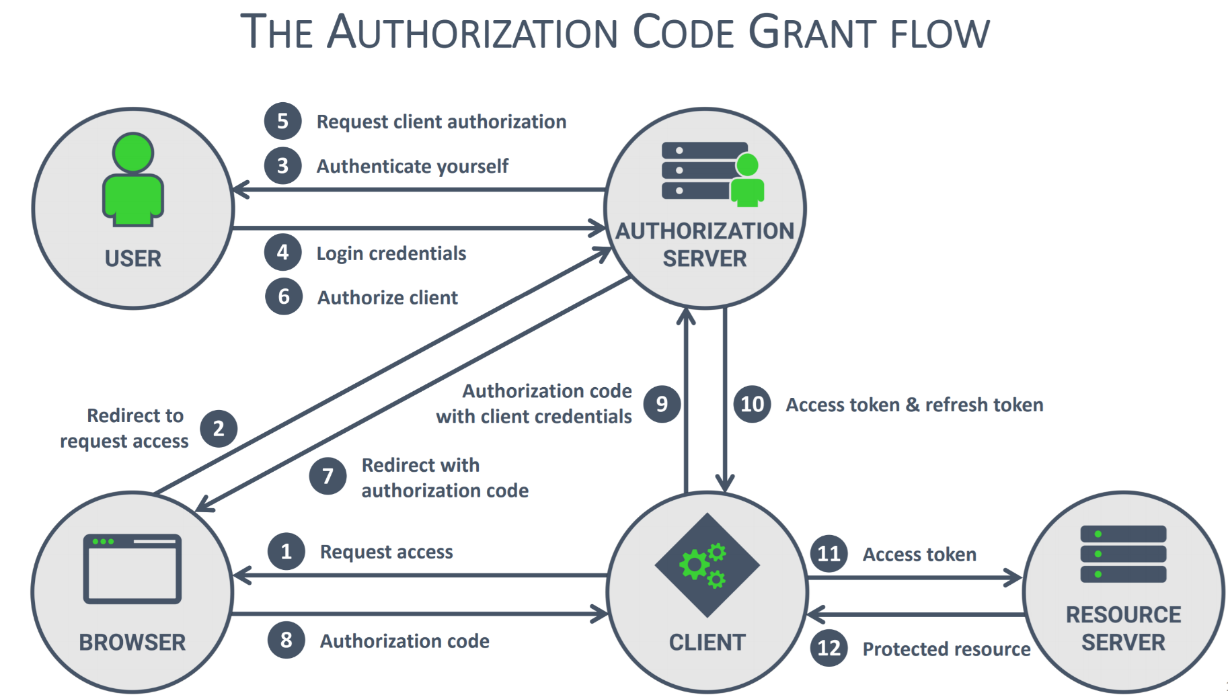
Human-To-Machine Communication with delegation

Slide 55
The Authorization Grant Code Grant Flow
Part 1
It is designed to let the user to authorize a backend application to access resources that belong to the user (delegation)
It uses user secrets which are assumed to be stored securely on a backend
the browser is redirected by the AS to the authentication EP
the EP presents the user with a login and then a authorization screen (would you like this app to access your resource x?)
the AS redirects the browser to a registered app URL and provides an Authorization Code so the backend application obtains the Authorization Code at the pre-registed URI

Slide 56
The Authorization Grant Code Grant Flow
Part 2
The backend presents the Authorization Code to the AS and exchanged it for an Access Token by presenting it with the client credentials
The Access Token is composed of the AT and the Refresh Token
The AT is a one-time use, short lived token
The AT is held on the backend and never passed on to the browser!
It is the most secure Authorization Flow
It is the most complex Authorization Flow

Slide 57
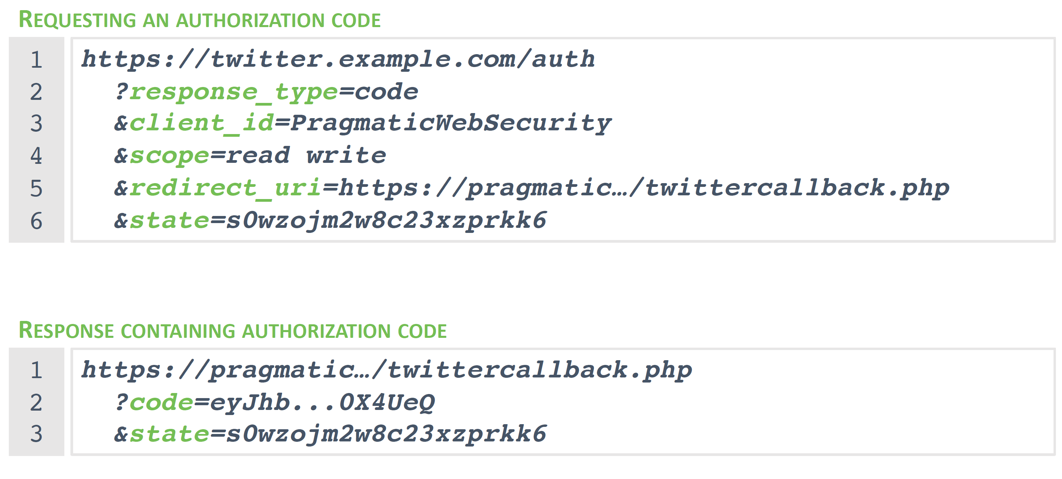
Browser-AS interaction

Slide 58
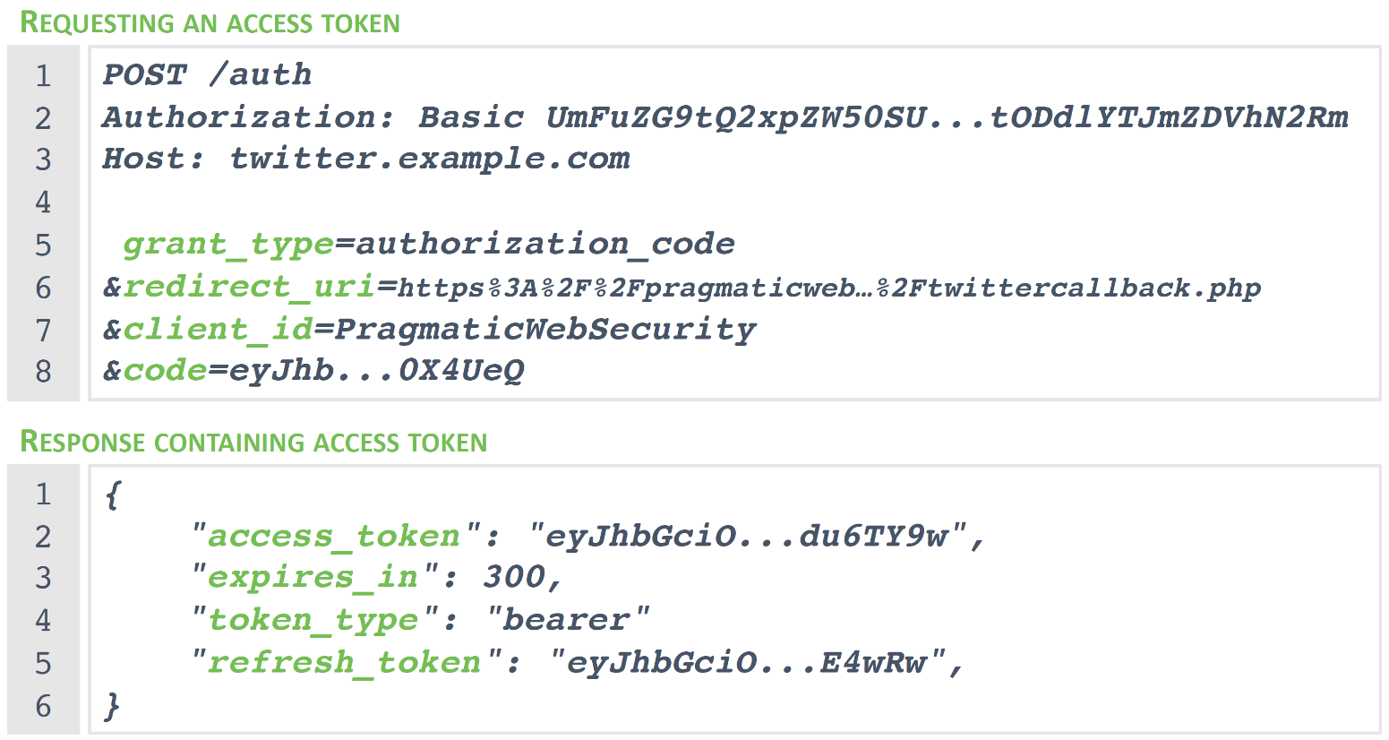
Client(Backend)-AS interaction
(Server-To-Server interaction)

Slide 59
The Authorization Grant Code Grant Flow
The state query parameter as anti-forgery token
The &state is a random value crated by the client when it issues the request
The client stores the &state value to validate the response
The client knows that the response is matched to its request and not that of a forging referrer
How this works its explained well here (OAuth2 Cross Site Request Forgery, and state parameter)

Slide 60
The Authorization Code Grant Flow
It is used to give delegated access to a backend app
The backend requires user interaction via their browser
The browser acquires the Authorization Code (AC)
The backend exchanges the Authorization code for a AT
Access Token (AT) can include a Refresh Token (RF)
It can only be used on backend because it must use client credentials to exchange AC for AT and these must be securely stored

Slide 61
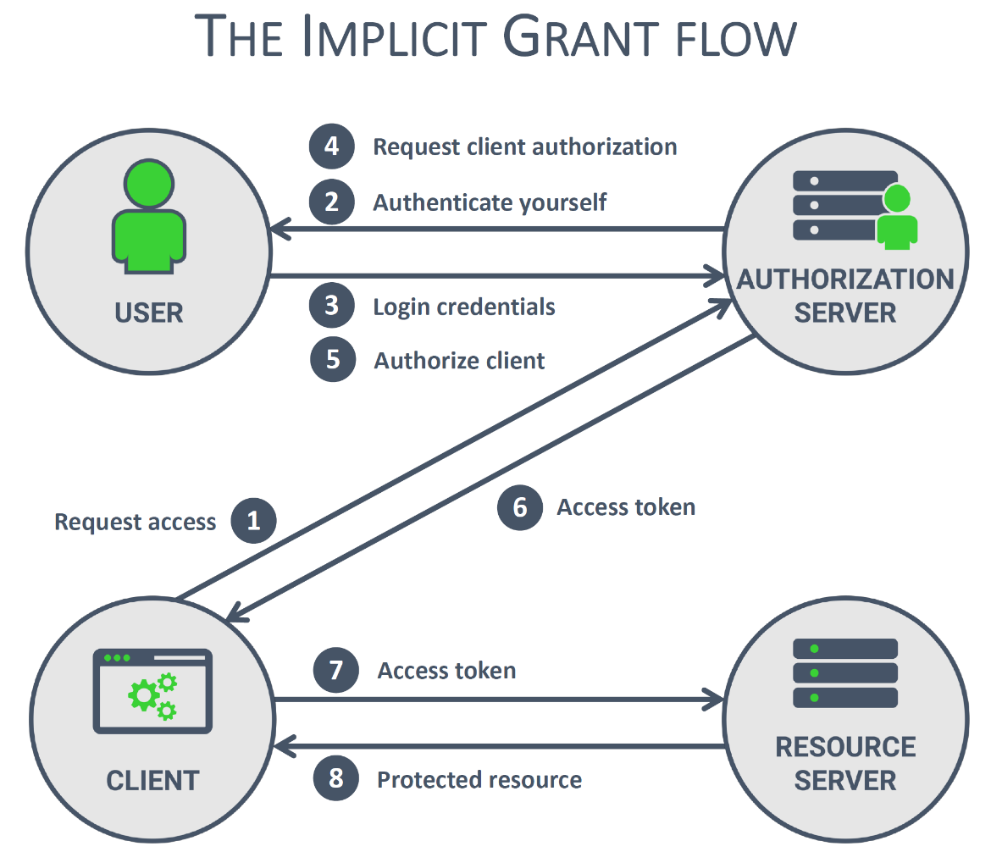
Frontend-To-Machine Communication with delegation

Slide 62
The Implicit Grant Flow
It is used in insecure frontend apps i.e. SPAs that require delegated access to their users resources
There is no backend as the app calls APIs directly
There is no safe storage for client secrets
The app gets an Access Token directly
This is the least secure and it is advised not to use it!
If used then make the AT short lived and maybe one-use only
Never use this flow on backends
There is no Refresh Token

Slide 63
Any Questions?

Slide 64
The People of Würth-Phoenix
Kathrin (HR?)
Mauro Sabbadini
Davide Spano (davide.spano@wuerth-phoenix.com)
Add…

Slide 65
BE OUR NEXT INSPIRATION MAKER!

